Slide 1


Bank Loan Case Study
Rahul M Ramchandani

Slide 2
Project description
Addressing the challenge of loan defaults among customers with limited credit history, this project utilizes Exploratory Data Analysis (EDA) to uncover patterns. The goal is to enhance the loan approval process, ensuring eligible applicants are not rejected while minimizing default risks.
When a customer applies for a loan, company faces two risks:
If the applicant can repay the loan but is not approved, the company loses business.
If the applicant cannot repay the loan and is approved, the company faces a financial loss.

Slide 3
When a customer applies for a loan, there are four possible outcomes:
Approved: The company has approved the loan application.
Cancelled: The customer cancelled the application during the approval process.
Refused: The company rejected the loan.
Unused Offer: The loan was approved but the customer did not use it.
As a Data Analyst my goal in this project is to use EDA to understand how customer attributes and loan attributes influence the likelihood of default.

Slide 4
Tech Stack used
Microsoft Excel 2021-Excel is a powerful spreadsheet software used for data organization, analysis, and visualization, facilitating efficient numerical calculations and creating dynamic charts.
Microsoft PowerPoint-PowerPoint is a presentation software that enables users to create visually engaging slideshows, making it an essential tool for conveying information, ideas, and messages in a professional and compelling manner.

Slide 5
Approach
Importing and Understanding the data
Perform various analysis to derive insights
Cleaning the data as per requirements
Visualizing outputs in graphs and charts

Slide 6
Tasks
A. Identify Missing Data and Deal with it Appropriately: Identify the missing data in the dataset and decide on an appropriate method to deal with it using Excel built-in functions and features.
B. Identify Outliers in the Dataset: Detect and identify outliers in the dataset using Excel statistical functions and features, focusing on numerical variables.
C. Analyze Data Imbalance: Determine if there is data imbalance in the loan application dataset and calculate the ratio of data imbalance using Excel functions.
D. Perform Univariate, Segmented Univariate, and Bivariate Analysis: Perform univariate analysis to understand the distribution of individual variables, segmented univariate analysis to compare variable distributions for different scenarios, and bivariate analysis to explore relationships between variables and the target variable using Excel functions and features.
E. Identify Top Correlations for Different Scenarios: Segment the dataset based on different scenarios (e.g., clients with payment difficulties and all other cases) and identify the top correlations for each segmented data using Excel functions.

Slide 7
Task A: Identify Missing Data
Identify the missing data in the dataset and decide on an appropriate method to deal with it using Excel built-in functions and features.
Using COUNT, IF and ISBLANK function to get number of null values for each column.
Then we will calculate percentage of null values for each column.
Using Transpose function we will convert rows to columns.
We will drop the columns which has more than or equal to 50% null values
We will drop irrelevant columns for doing our analysis

Slide 8
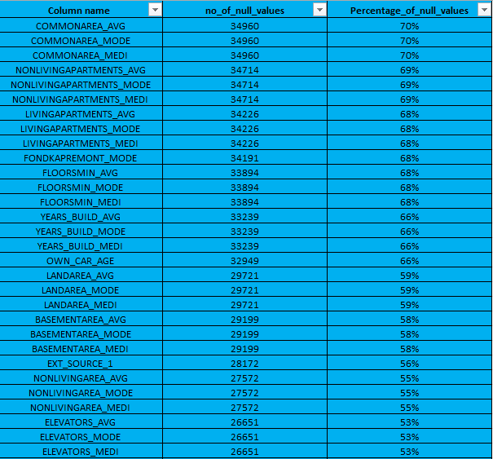
These are the columns which has null values. These columns need to be dropped. Check the full list in the Null values chart excel file

Slide 9
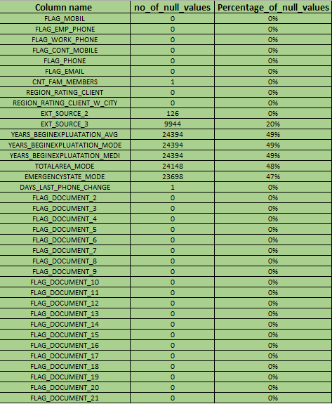
These are the columns which contain irrelevant data for analysis and are not needed so these columns need to be dropped.

Slide 10
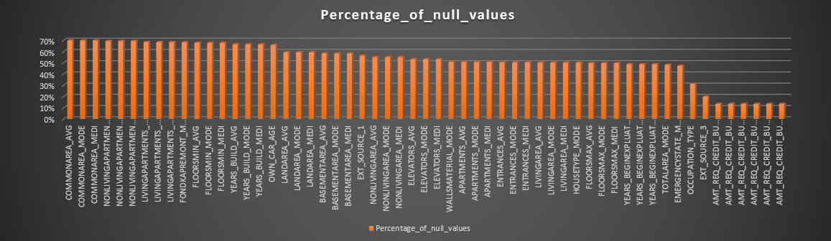

Slide 11
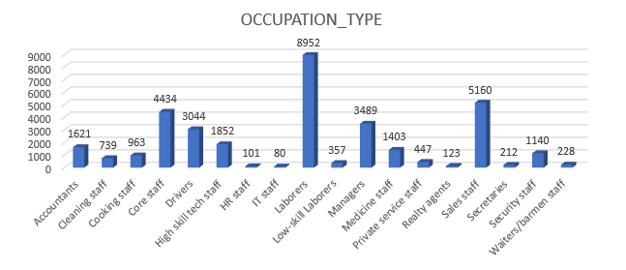
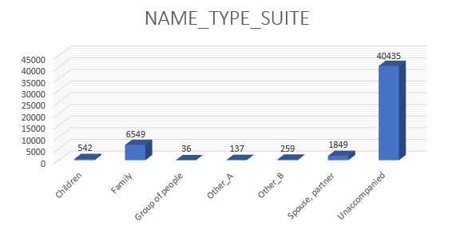
Missing Data
Mode Imputations- 1. OCCUPATION_TYPE 2. NAME_TYPE_SUITE

Slide 12
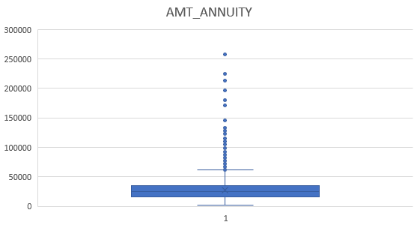
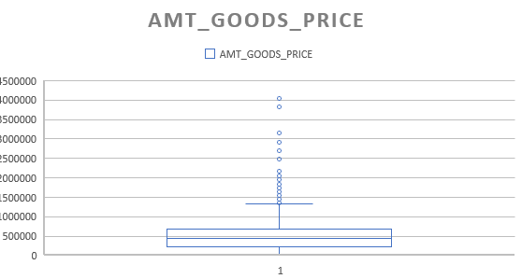
Missing Data
Median Imputations- 1. AMT_ANNUITY 2. AMT_GOODS_PRICE

Slide 13
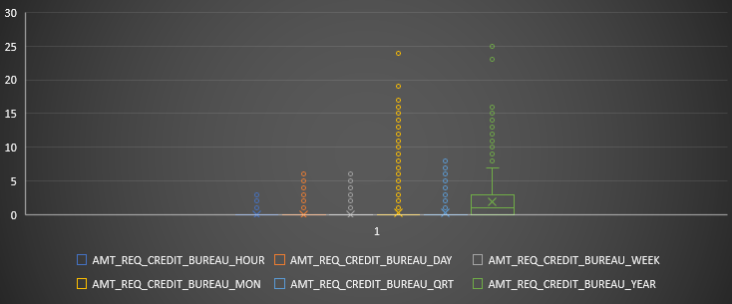
AMT_REQ_CREDIT_BUREAU_HOUR
AMT_REQ_CREDIT_BUREAU_DAY
AMT_REQ_CREDIT_BUREAU_WEEK
AMT_REQ_CREDIT_BUREAU_MON
AMT_REQ_CREDIT_BUREAU_QRT

Slide 14
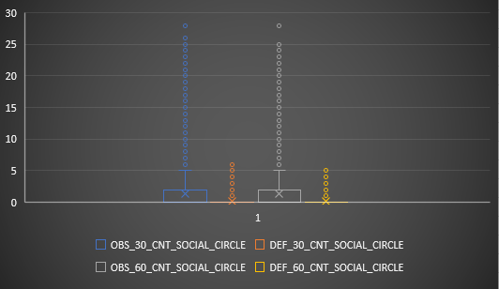
Median/Mode Imputations

Slide 15
Task B: Outliers
Detect and identify outliers in the dataset using Excel statistical functions and features, focusing on numerical variables.
Using Excel functions like QUARTILE, IQR, and conditional formatting to identify potential outliers.
First we will select numerical columns like AMT_INCOME_TOTAL and AMT_CREDIT
Calculate Quartile 1, Quartile 3, IQE, Upper Limit and Lower Limit
We will use Box Plot to highlight the Outliers
Formulas-
Quartile 1: =QUARTILE(A:A,1)
Quartile 3: =QUARTILE(A:A,3)
IQR= Quartile 3 Quartile 1
Upper Limit - Quartile 3+1.5*IQR
Lower Limit - Quartile 1-1.5*IQR

Slide 16
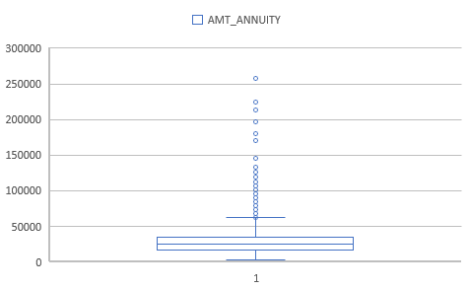
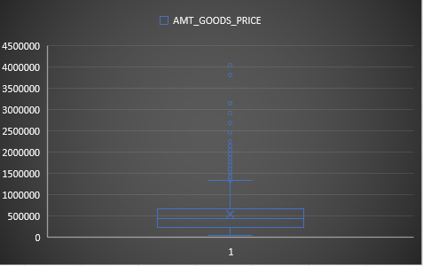
Outliers
These columns are outliers

Slide 17
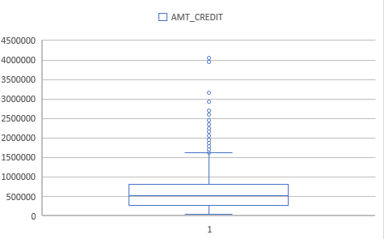
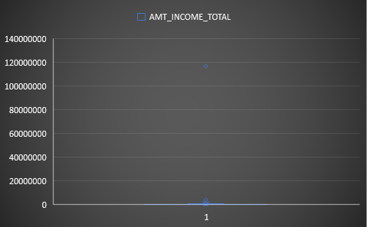
Outliers
There are few outliers in columns like AMT_CREDIT and AMT_INCOME_TOTAL whrre amount is higher than normal. In AMT_INCOME+TOTAL one of extreme outlier is 117000000 but we will not remove because income of person varies.

Slide 18
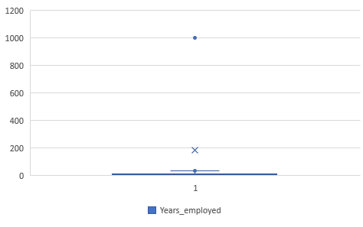
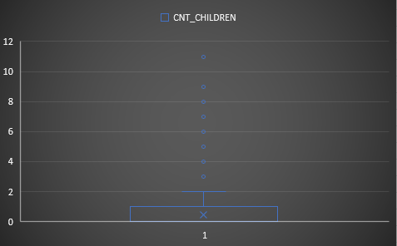
Outliers
In columne Years_employed we can see people being employed for 1001 years which is not possible. Column CNT_CHILDREN shows people are having 11 children which is impossible

Slide 19
Task C: Data Imbalance
Determine if there is data imbalance in the loan application dataset and calculate the ratio of data imbalance using Excel functions.
Using COUNTIF and SUM to calculate the proportions of each class.

Slide 20
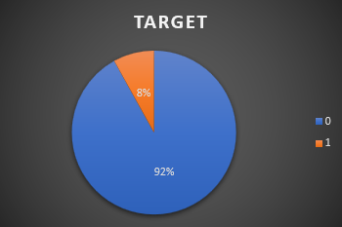
Target Column-
0- Payment on time 1- Late Payment
Row Labels | Count of TARGET
0 | 45973
1 | 4026
Grand Total | 49999

Slide 21
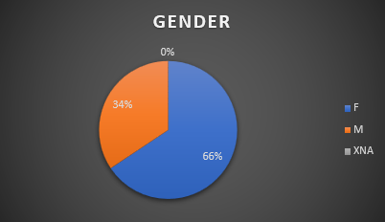
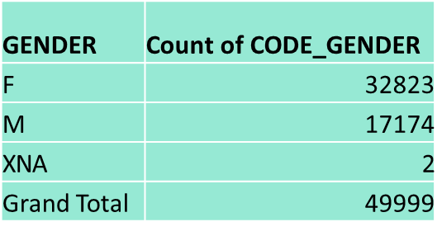
CODE_GENDER Column-
66% clients are female 34% clients are male

Slide 22
Task D: Univariate, Segmented Univariate and Bivariate Analysis
Perform univariate analysis to understand the distribution of individual variables, segmented univariate analysis to compare variable distributions for different scenarios, and bivariate analysis to explore relationships between variables and the target variable using Excel functions and features.
Utilize Excel functions like COUNT, AVERAGE, MEDIAN, and statistical functions for descriptive analysis. Utilize Excel features like filters, sorting, and pivot tables for segmented and bivariate analysis.

Slide 23
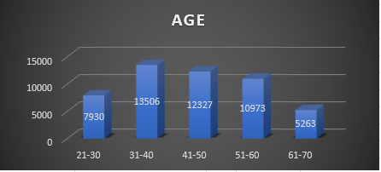
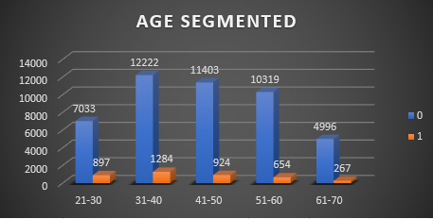
Univariate/Segmented Univariate Analysis
Majority of the clients are in age group 31-40
We can see as age increases chances of defaulter decreases

Slide 24
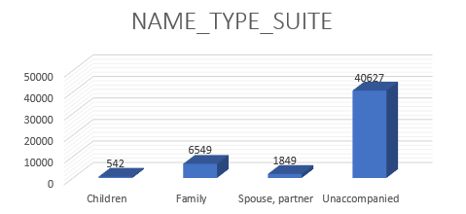
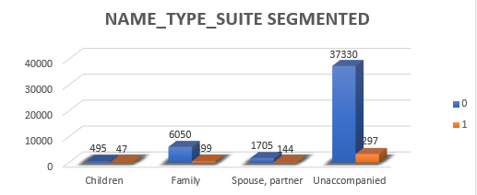
Univariate/Segmented Univariate Analysis
Majority of the clients Unaccompanied followed by family

Slide 25
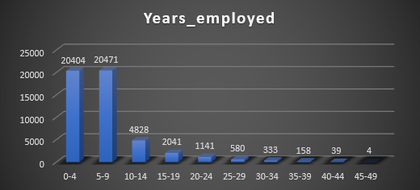
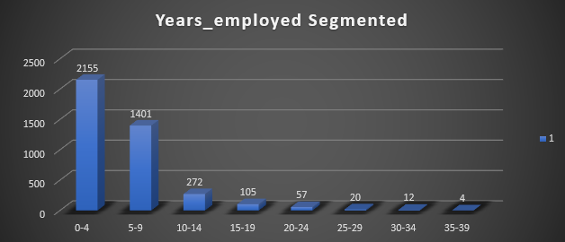
Univariate/Segmented Univariate Analysis
Majority of the clients are having 0-9 years of experience
As we can see from the above figure, as experience increases, chances of defaulting decreases

Slide 26
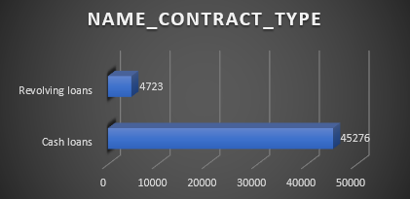
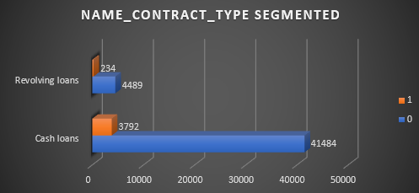
Univariate/Segmented Univariate Analysis
Majority of the clients are taking Cash loans

Slide 27
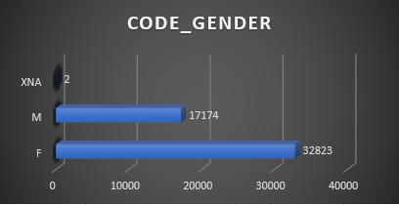
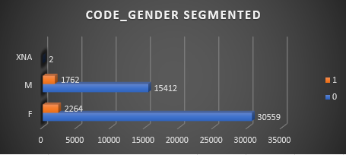
Univariate/Segmented Univariate Analysis
Male are less defaulters compared to females

Slide 28
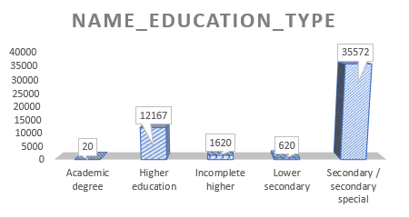
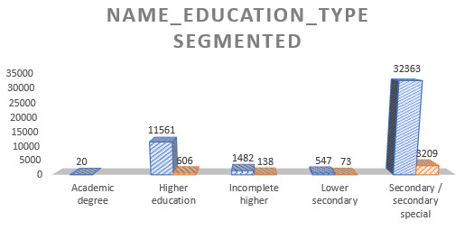
Univariate/Segmented Univariate Analysis
The number of loans taken by clients with Secondary/Special Education is the highest and Academic degree is the lowest
Least default: Academic Degree
Highest default: Secondary Special

Slide 29
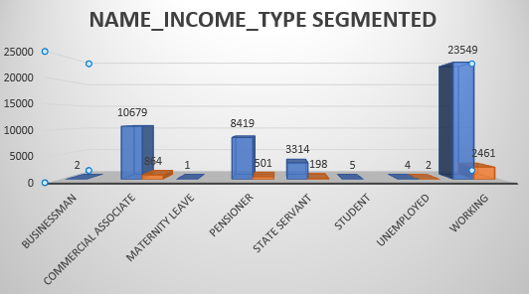
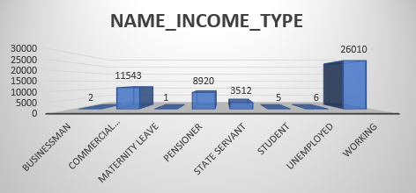
Univariate/Segmented Univariate Analysis
Bank target those group whose income type is working Least default: Client who is Businessman or Student or at Maternity Leave
Highest default: Client who is working

Slide 30
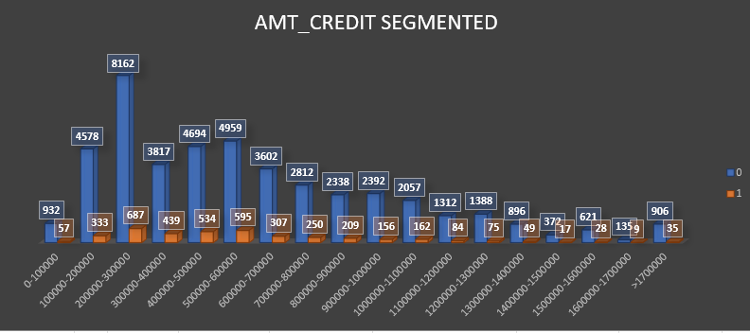
Univariate/Segmented Univariate Analysis
Majority of the clients took loan between 2L - 3L

Slide 31
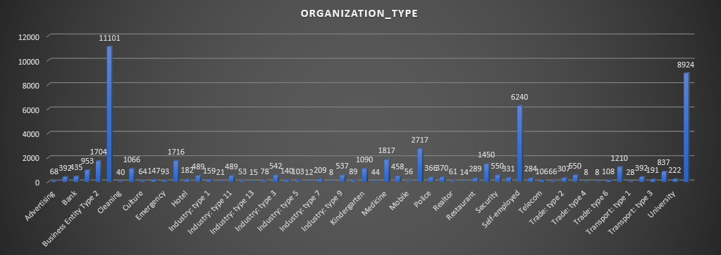
Univariate/Segmented Univariate Analysis
Clients who are working for Business Entity type of Organization took the highest number of loans

Slide 32
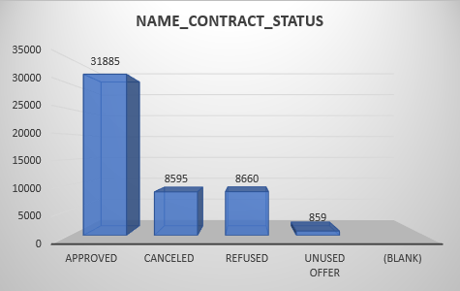
Univariate/Segmented Univariate Analysis
Previous_application Dataset-
More number of clients were approved for loan previously

Slide 33
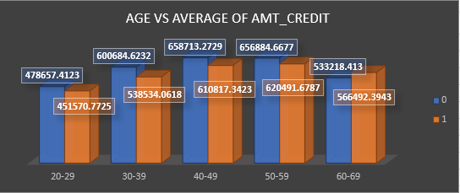
Bivariate Analysis
Age group 40-49 took the highest amount of loan but the age group 50-59
Are defaulter with highest amount of loan

Slide 34
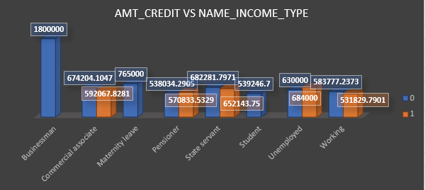
Bivariate Analysis
As we see businessman took the highest amount of loan and did the
Payment on time. Clients who are unemployed have the highest amount of loan which they didn’t repay on time

Slide 35
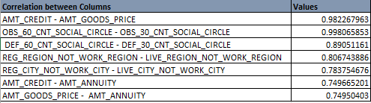
Task E: Correlations
Understanding the correlation between variables and the target variable can provide insights into strong indicators of loan default.
Top Correlations Coefficients for Payment difficulties are:

Slide 36
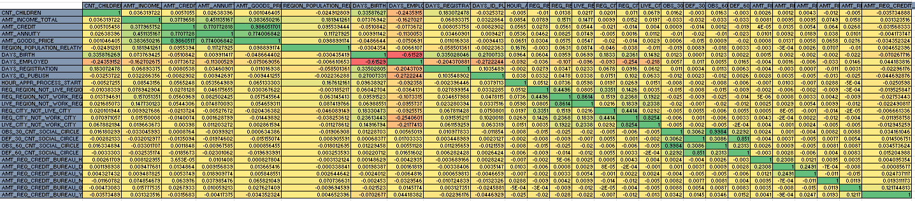
Correlations

Slide 37
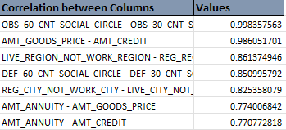
Correlations
Top Correlation coefficient for Re-Payers are:

Slide 38
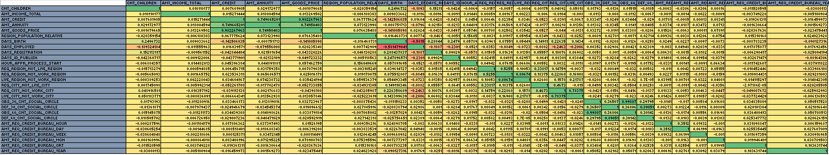
Correlations

Slide 39
Conclusion/Insights
Most of the clients are loan re-payers.
The Bank generally lends more loan to Female as compared to Male but Male are less defaulters compared to Female.
As age and experience increases , chances of defaulter decreases.
Most of the clients are taking cash loans.
Educated clients tend to less defaulter compared to clients with lower education such as secondary special education so Bank should prefer clients with having such education status.
As number of children increases, number of client who take loan decreases.
The Bank should be more cautious when lending money to clients who are unemployed because they are the most defaulters with highest amount of credit.
As age increases amount taken by Clients are considerably high but with higher age defaulter percentage is lower. These are least risky and more profitable for Bank.

Slide 40
Google Drive Link
Google drive link for excel sheets are-
Bank Loan Case Study

